Slide 1
Cleopatra Connecting Locations of ESFRI Observatories and Partners in Astronomy for Timing and Real-time Alerts
Arpad Szomoru
Joint Institute for VLBI ERIC (JIVE)
On behalf of the Cleopatra collaboration

Slide 2
What is ASTERICS?
A €15 million Research Infrastructure funded by EC Horizon 2020 framework (2015-2019)
To help solve the Big Data challenges of European astronomy
To provide direct interactive access to the best European astronomy data in an international framework
Address common challenges in astronomy and astroparticle physics
Cross-cutting synergies and common challenges

Slide 3
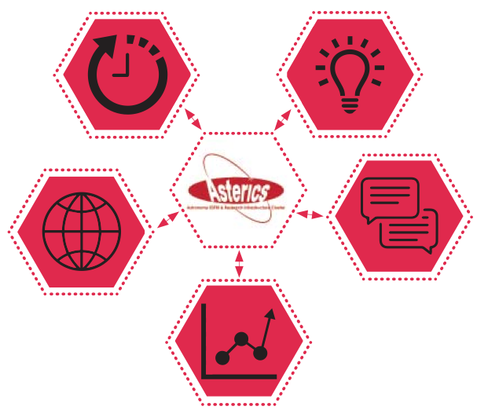
CLEOPATRA: Connecting Locations of ESFRI Observatories and Partners in Astronomy for Timing
and Real time Alerts)
Management
DECS: Disseminaton, Engagement and Citizen Science
DADI : Data Access, Discovery and Interoperability
OBELICS: OBservatory E-environments LInked by common ChallengeS

Slide 4
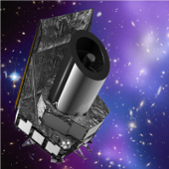
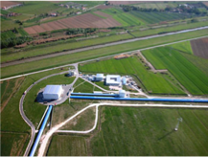
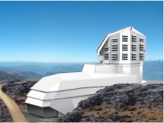

WP5: Cleopatra
Connecting real facilities now as path to connected future facilities
Euclid
EGO/Virgo
~2.5 M€, 4 tasks

Slide 5
Task 1: Synchronization VU, ASTRON, JIVE, UGR, FOM, DESY, SURFnet (Koelemeij, Berge)
Time and frequency transfer on optical fiber networks through White Rabbit Ethernet (WRE)

Slide 6
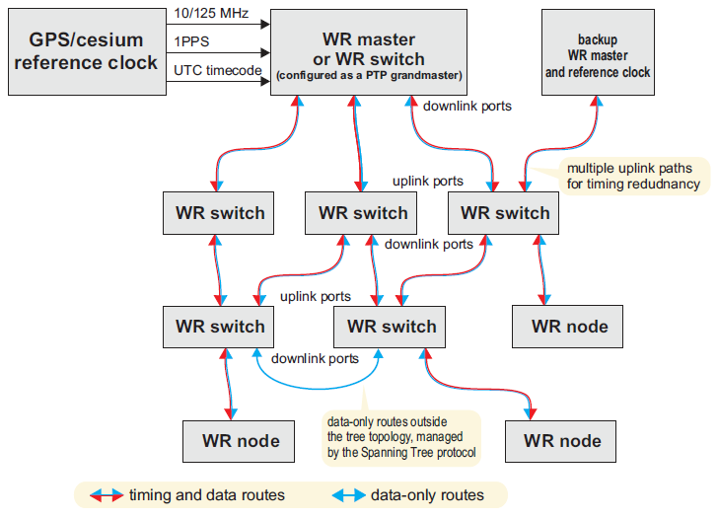
What is White Rabbit?
White Rabbit Ethernet (CERN, based on IEEE Precision Time Protocol)
Atomic clock
Time, frequency, and 1 Gb/s data in one
1 PPS, 10 – 125 MHz
Designed for 1 ns timing over distances <10 km (LHC, CERN)
Commercially available

Slide 7
Task 1: Synchronization VU, ASTRON, JIVE, UGR, FOM, DESY, SURFnet (Koelemeij, Berge)
Time and frequency transfer on optical fiber networks through White Rabbit Ethernet (WRE)
Alternative to the intricate and custom-built timing solutions used in previous neutrino telescopes and radio telescope arrays
Enable highly synchronized real-time observations by widely separated instruments, providing a unique "multi-messenger” view of astrophysical phenomena
Back-up or augment timing and navigation through the Global Navigation Satellite Systems
Centimeter-level positioning for indoor navigation
Autonomous vehicles using hybrid optical/wireless networks

Slide 8
WRE and VLBI: a demo
Need three orders of magnitude improvement in frequency stability
New calibration and characterization tools
Bi-directional light paths on operational fiber-optic telecommunication networks

Slide 10
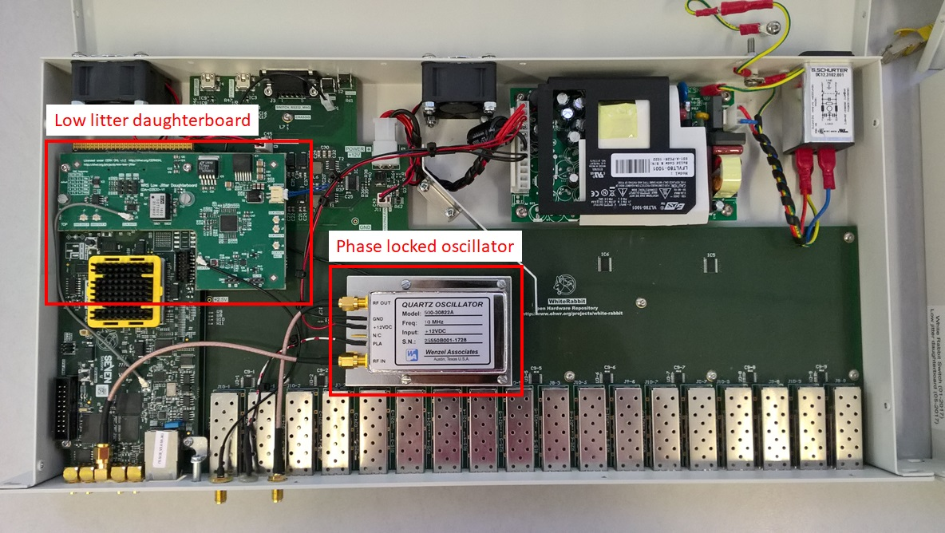
Task 1: WRE developments
Use of Optical Supervisory Channel: fed into requirements of SURFNet8 acquisition
Ultra-low-noise White Rabbit (WR) switches
phase noise comparable to that of an H-maser
long-term stability better than an H-maser (https://library.nrao.edu/public/memos/ngvla/NGVLA_22.pdf)
Improved absolute calibration of WR equipment
Relative calibration procedure produced
Applicable on large scales (hundreds of nodes like in the CTA)

Slide 11
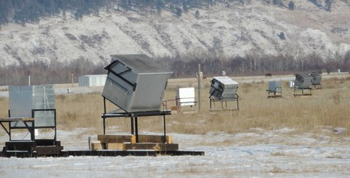
Task 1: WR in harsh environments
Completed the setup of a foton detector network in Siberia equipped with WR nodes.
This network can and will be used to test various types of WR hardware in harsh circumstances (Proceedings of science POS (ICRC2017) 754, 759, 768)

Slide 12
Task 2: Multi-messenger methods JIVE, ASTRON, CNRS-APC, UVA (Kettenis)
Develop standards for generation, dissemination, distribution and reaction to transient events (based on VOEvents)
Demonstration during which e.g. radio facilities like LOFAR, EVN, follow up a GW event
Investigate scientific synergies for automated follow-up observations

Slide 13
Need for speed
Coherent Emitters
Incoherent Emitters
Revolutionary science
Current capability (LOFAR)

Slide 14
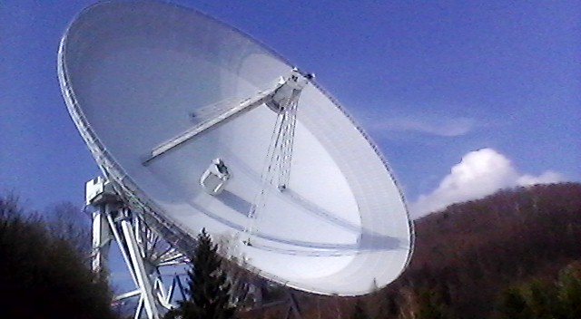
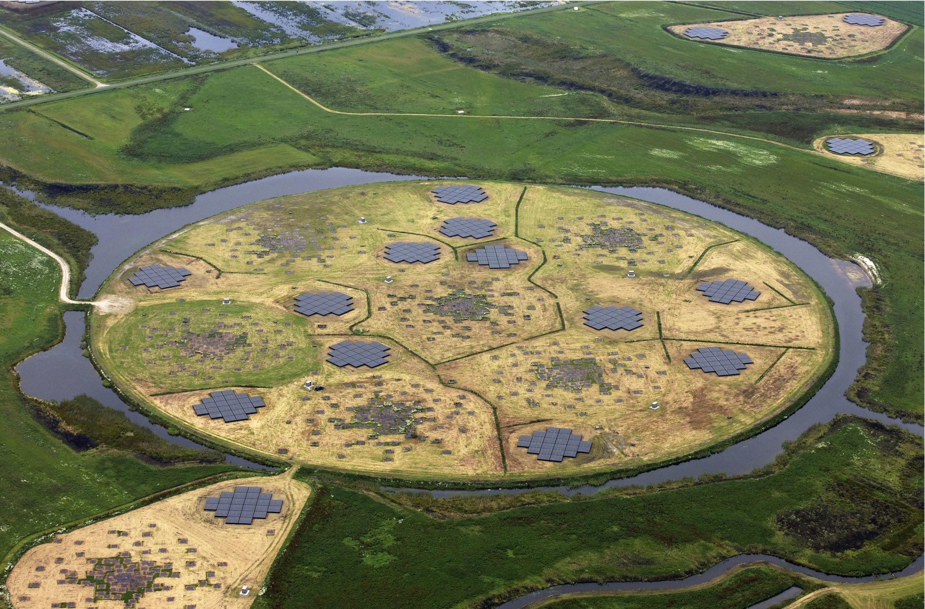
First commissioning test: Transient Buffer Boards triggered from Effelsberg detection
Effelsberg 100m telescope
High frequency detection
LOFAR
Low frequency observation
Localization

Slide 15
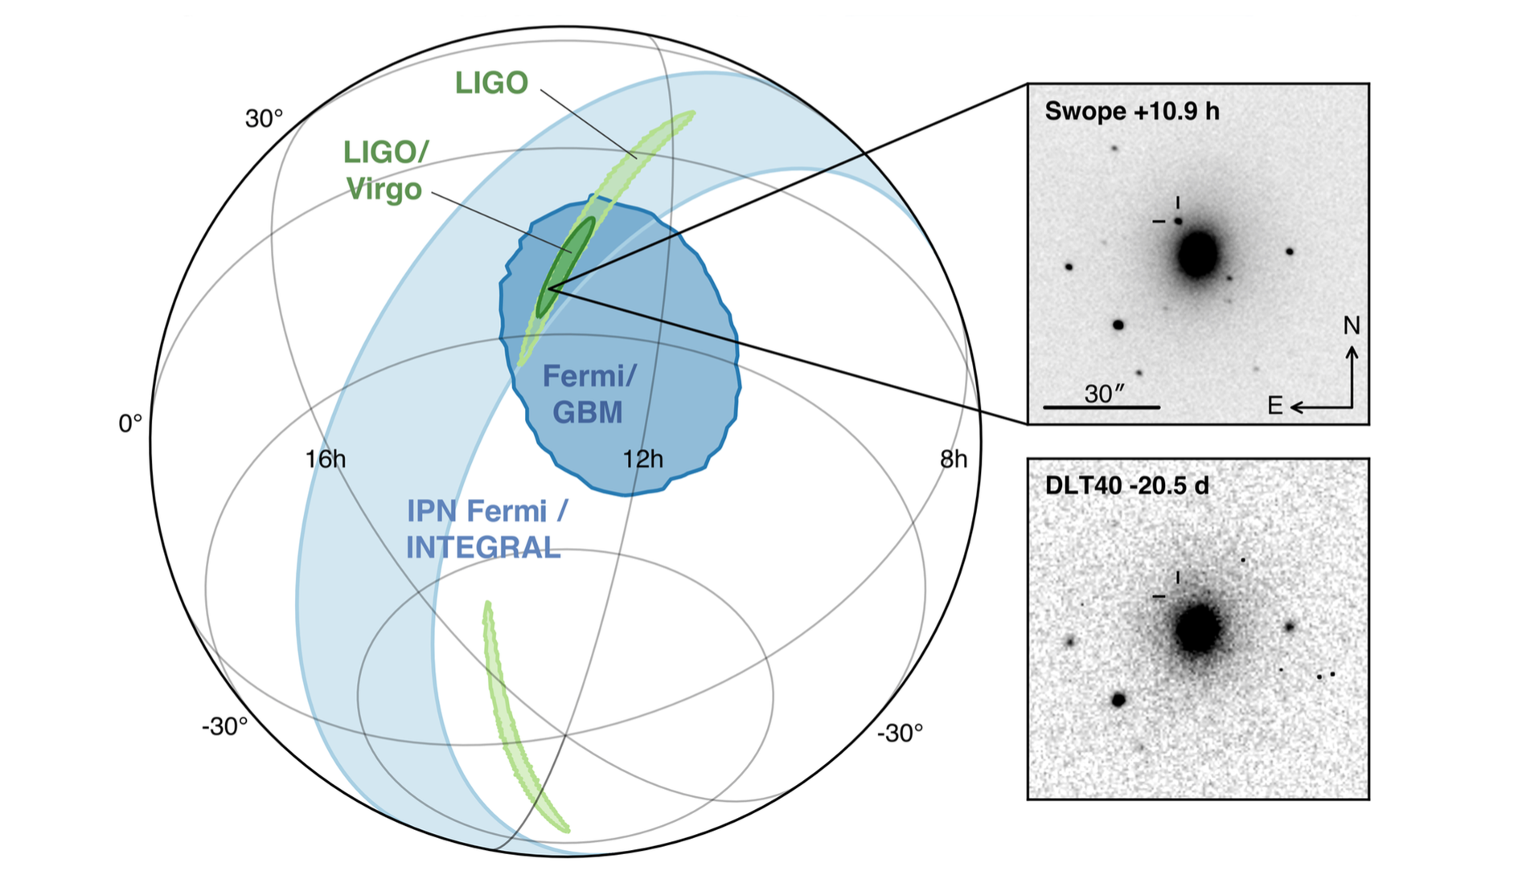
Task 2: results
Design document on the handling of multi-messenger alerts
Through Cleopatra, an MoU was signed between observers from JIVE and the EVN and the LIGO/Virgo collaboration
Enabling high resolution radio follow-up observations to GW events

Slide 16
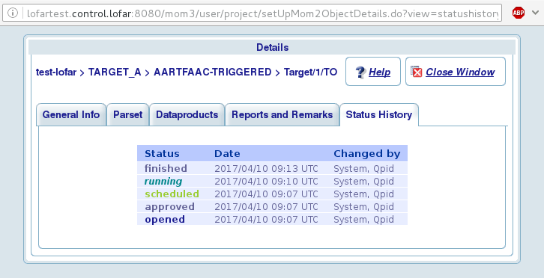
Task 2: results
Realistic way of chaining alerts between LIGO/Virgo, LOFAR and the EVN,
needed for the pilot in multi-messenger event handling
The LOFAR Responsive Telescope came online, enabling rapid response (within minutes) of LOFAR to transient events
Very successful workshop in Amsterdam in September 2017, on Transient Alert Mechanisms
https://indico.astron.nl/conferenceDisply.py?ovw=True&confId=62
About 40 participants, representing a wide variety of astronomical observatories.
Task 4 participated with a special afternoon session.

Slide 17
Challenges
Many different instruments are needed, and available, for follow-up of transient events
With completely different methods of scheduling, configuration, response time
Filtering: number of transient detections will only increase (explode?)
Ensure all necessary information is contained in message
Define standards for the generation of triggers from triggered observations
Involve outside parties (from small optical telescopes to space programmes) in these developments

Slide 18
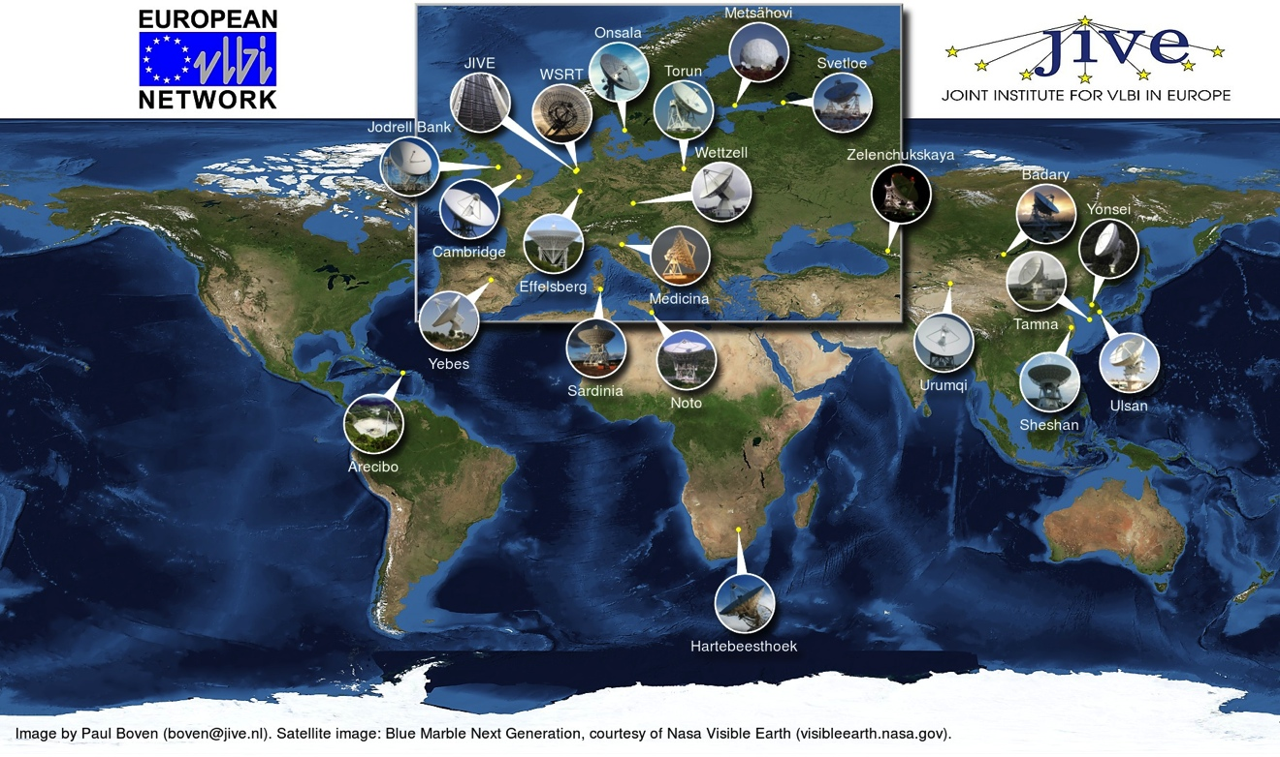
Task 3: User-domain data streaming JIVE (Verkouter)
Almost all high-throughput data transfer utilities use TCP
Abysmal performance on long-haul links
Experience with lossy real-time and reliable near-real-time data transfer through development of e-VLBI
But, (e-)VLBI software is way too specialized and non-standard for simple file-to-file transfers

Slide 19
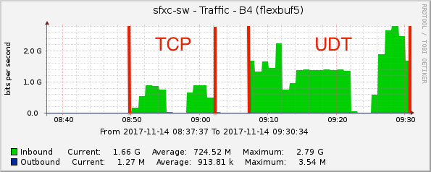
Task 3: first results
Developed file transfer utility (in C++11) using the (reliable) UDT protocol
Server-client, properly daemonised, capable of file transfers between external machines
Next step: bandwidth discovery
Semi-automatic

Slide 20
Task 4: Scheduling of large astronomical infrastructures IEEC, STFC, GTD (Colome)
Complex, many-element detector arrays

Slide 21


CTA observation modes
Monitoring
4 telescopes
Monitoring
4 Telescopes
Monitoring
4 telescope
Deep field
~1/2 of telescopes
Deep field
~1/3 of telescopes
Monitoring
1 telescope
Divergent & convergent mode in
SUB-ARRAY configuration

Slide 22
Task 4: Scheduling of large astronomical infrastructures IEEC, STFC, GTD (Colome)
Complex, many-element detector arrays
Artificial Intelligence (AI) techniques to optimize procedures
Metaheuristic Optimization: Genetic Algorithms, Multi-objective Evolutionary Algorithms
Constraint-Based Reasoning: constraint propagation
Maximize science return of SKA and CTA
But ensure solutions are applicable for other instruments
Incorporate multi-frequency, multi-messenger astrophysics
Provide a framework to coordinate and schedule multiple facilities.

Slide 23
Task 4: Scheduling hierarchy
Single telescope
Single telescopes with alerts
Single array telescope (CTA, SKA,…)
Single observatory with multiple sites (VLBI, CTA, SKA,…)
Multilateral cross-facility coordination

Slide 24
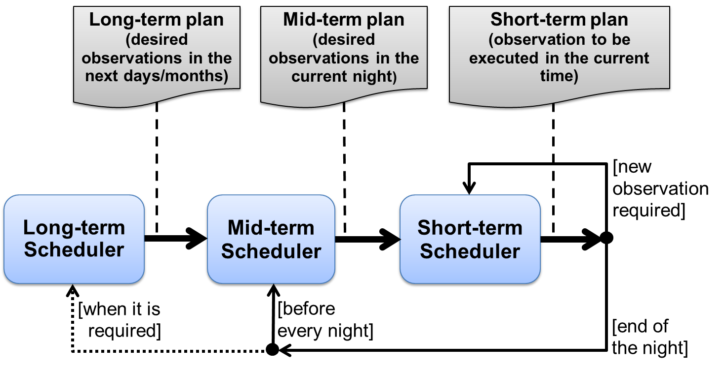
Task 4: Scheduling strategies
Open loop: long-term/static plan & short-term plan are not connected
Closed loop: short- and long-term perspectives are connected

Slide 25
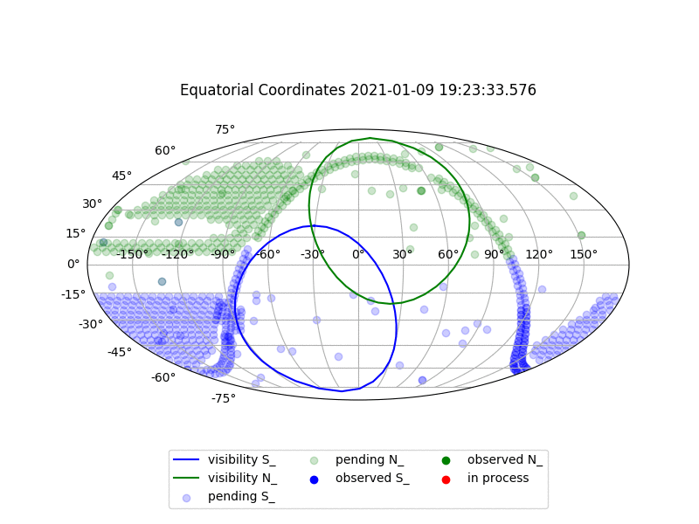
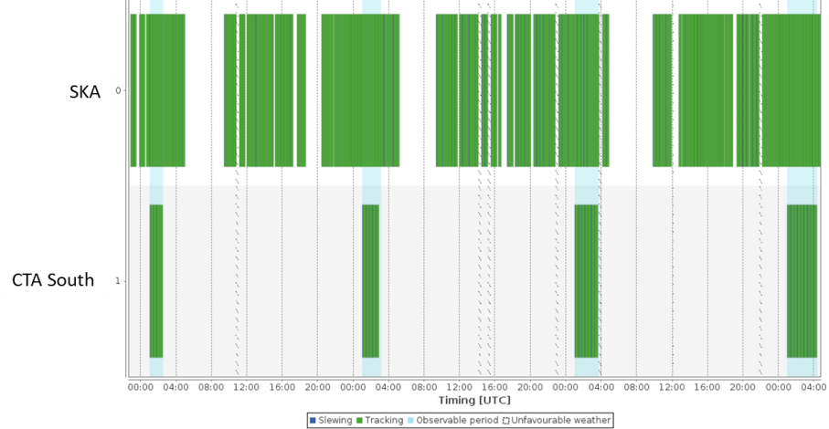
Task 4: Scheduling large infrastructures and multi-facility coordination
CTA N&S

Slide 26
Conclusions
Cleopatra is well on its way
Already has made a real impact on WR development
Generated outside interest: JVLA
Has produced a simple file-transfer tool that actually simply works
Is making excellent progress in dynamic scheduling of large arrays/global arrays
Will implement and demonstrate streamlined methods of filtering of and responding to triggering events

Slide 27


Participating institutions

Slide 28
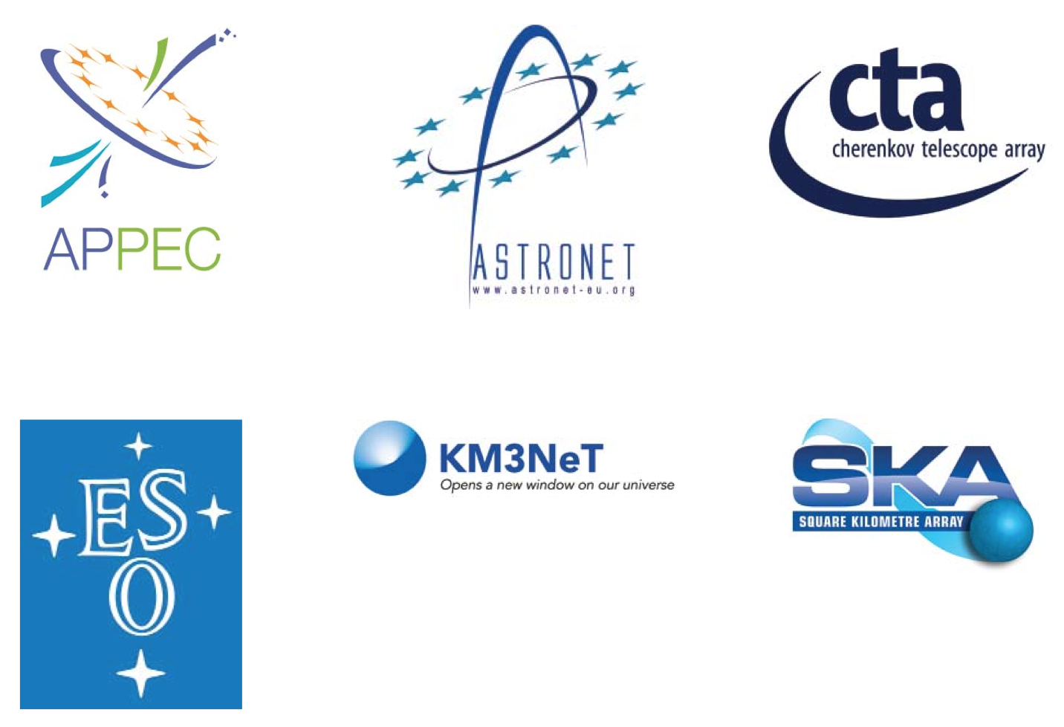
Supporting organisations and networks

